Slide 1
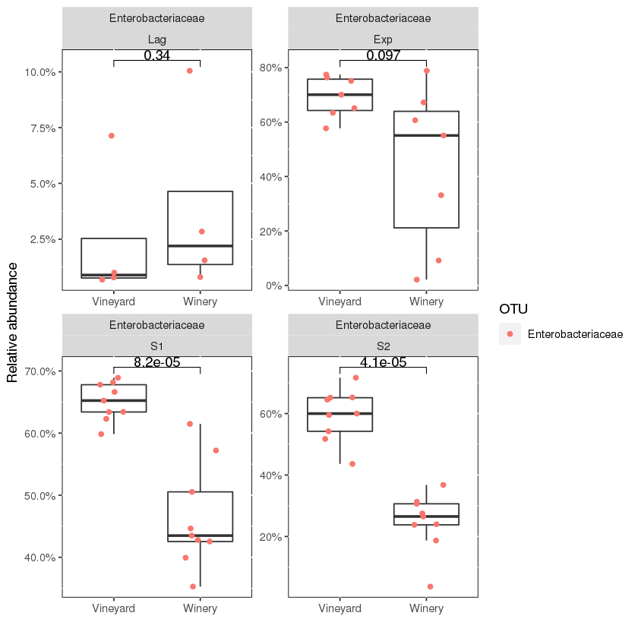
A
Lag
Exp
S1
S2
Enterobacteriaceae
A) Shows the significant difference (p <0.05) of Enterobacteriaceae family at the S1 and S2 phase.
Lag = Lag phase – days 1-4; Exp = Exponential phase – days 5-11; S1 = Early stationary phase 1 – days 12 - 20; S2 = Late stationary phase 2 – day 21 - 28AP.

Slide 2
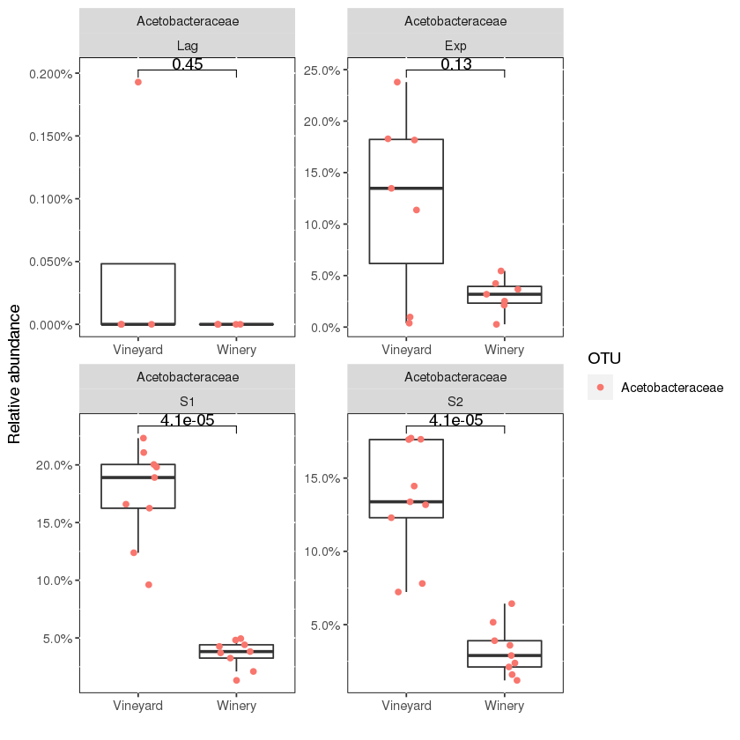
B
Lag
Exp
S1
S2
Acetobacteraceae
B) Shows the significant difference (p <0.05) of Acetobacteraceae family at the S1 and S2 phase.
Lag = Lag phase – days 1-4; Exp = Exponential phase – days 5-11; S1 = Early stationary phase 1 – days 12 - 20; S2 = Late stationary phase 2 – day 21 - 28AP.

Slide 3
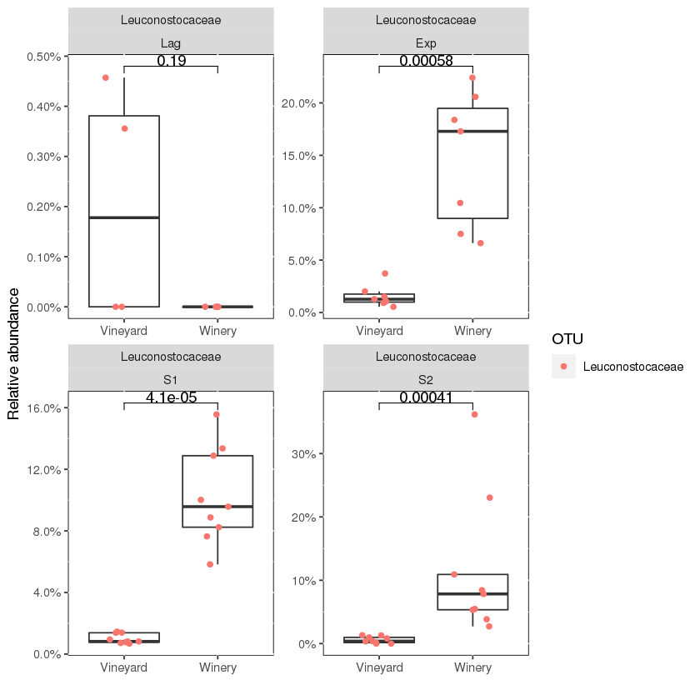
C
Lag
Exp
S1
S2
Leuconostocaceae
C) Shows the significant difference (p <0.05) of Leuconostocaceae at the Exp, S1 and S2 phase.
Lag = Lag phase – days 1-4; Exp = Exponential phase – days 5-11; S1 = Early stationary phase 1 – days 12 - 20; S2 = Late stationary phase 2 – day 21 - 28AP.

Slide 4
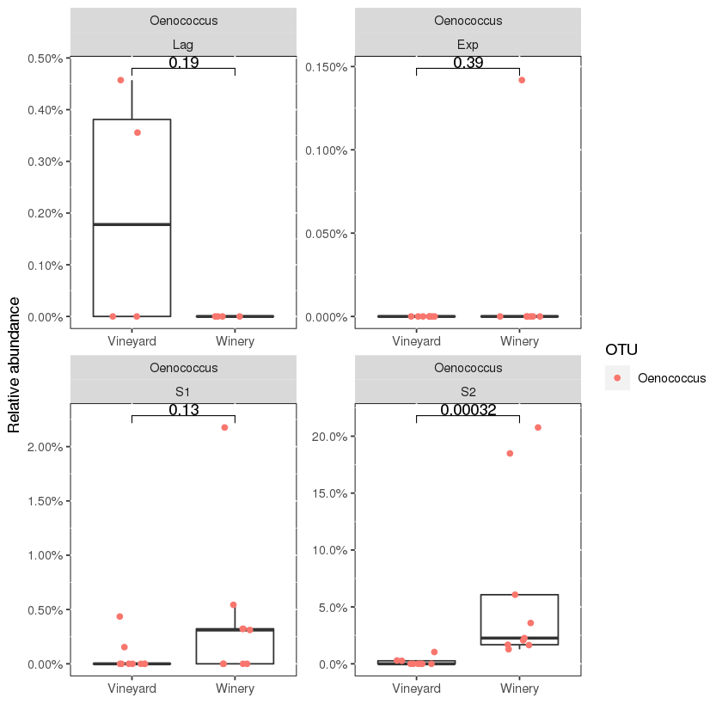
D
Lag
Exp
S1
S2
Oenococcus
Figure D) Shows the significant difference (p <0.05) of Oenococcus at the S2 phase.
Lag = Lag phase – days 1-4; Exp = Exponential phase – days 5-11; S1 = Early stationary phase 1 – days 12 - 20; S2 = Late stationary phase 2 – day 21 - 28AP.

